Slide 1
The Battle of Neighborhoods
Authentic Sri Lankan Food Search

Slide 2
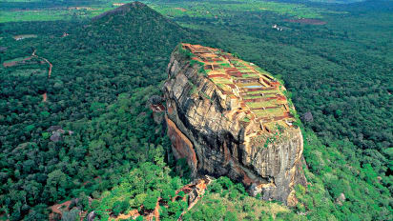
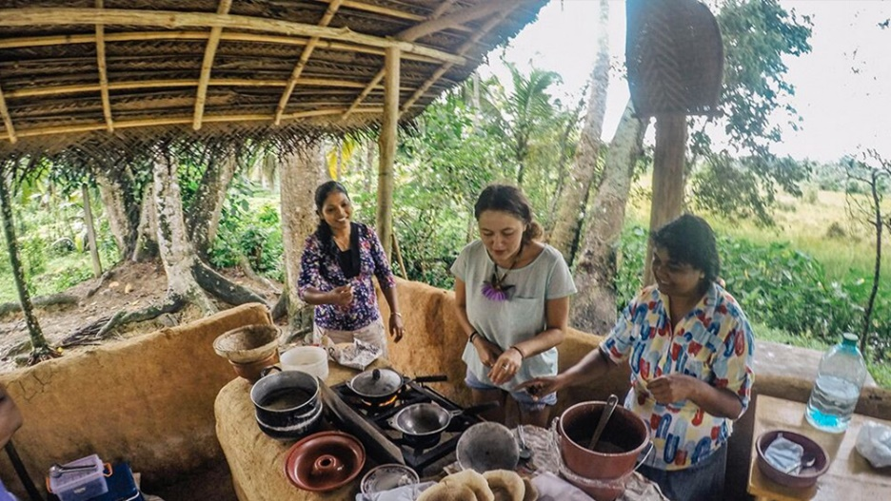
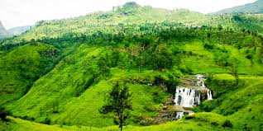
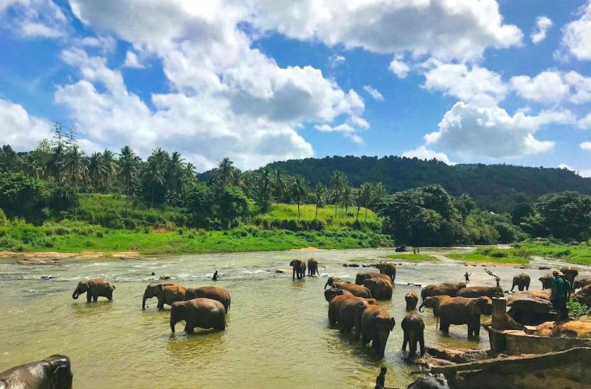
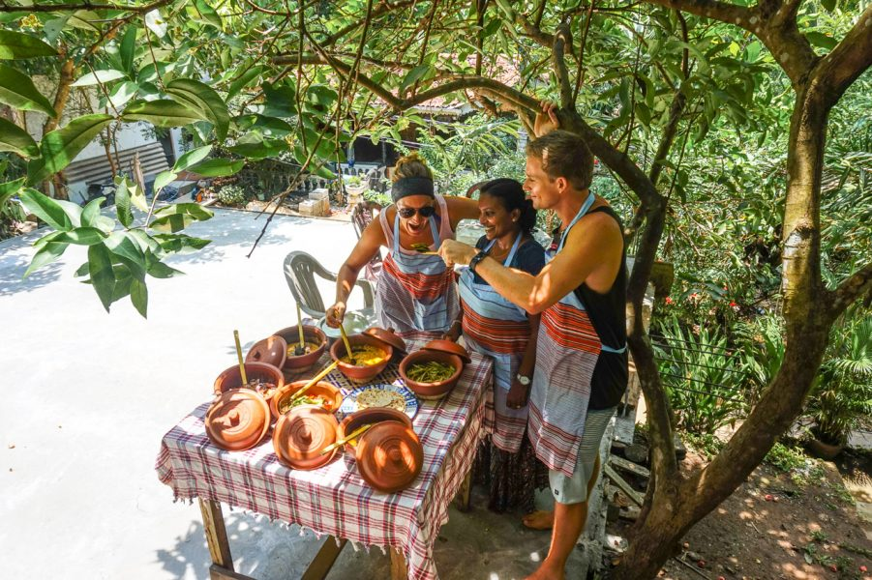
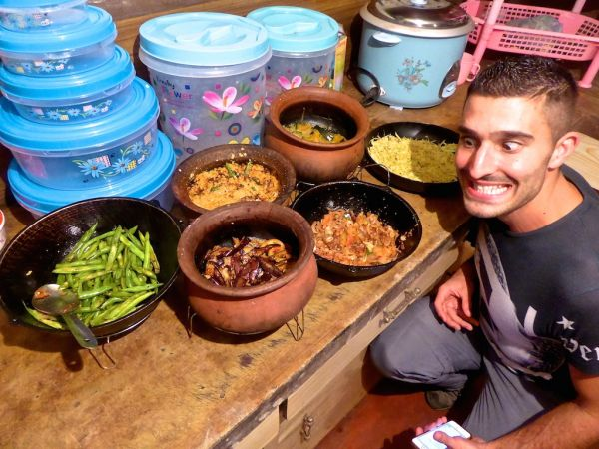
Sri Lanka Not only famous for sceneries' but also for food

Slide 3
Problem and Solution
Most of the tourists coming to Sri Lanka is trying to experience the authentic Sri Lankan food.
Trip planning
Awesome sceneries and food
Sri Lanka
Locations ?
Authentic Sri Lankan Food ?
Thousands of web sites Blogs
Our Problem to solve
Find areas with more authentic food, can help to plan trip well

Slide 4
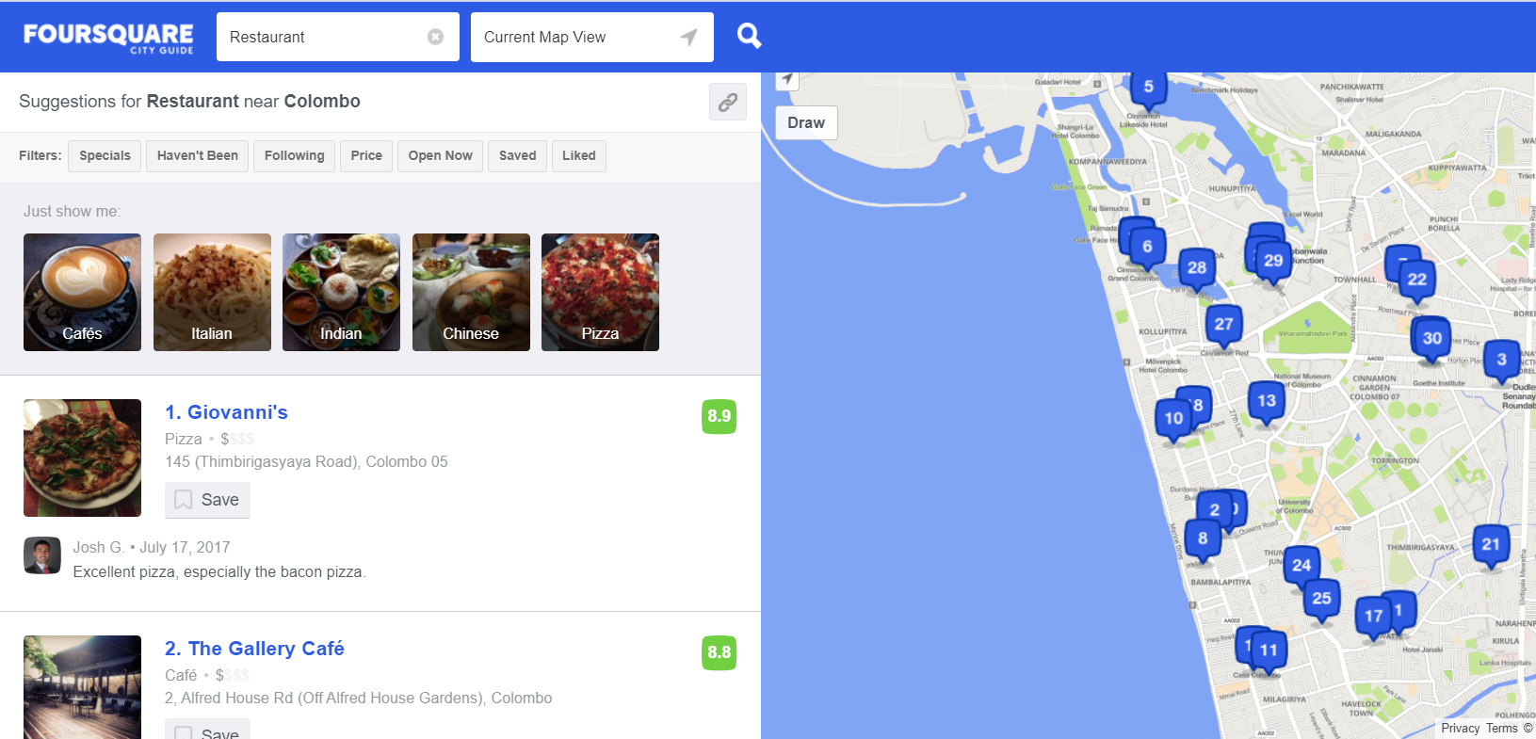
Data
Wikipedia – To get Sri Lanka Districts details
Foursqure.com – To get restaurant details

Slide 5
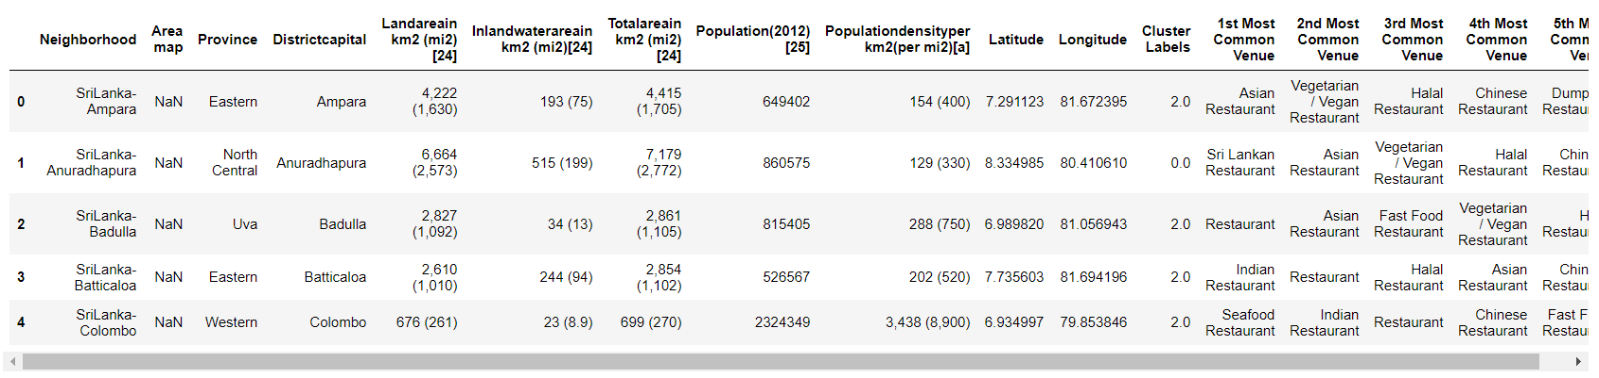
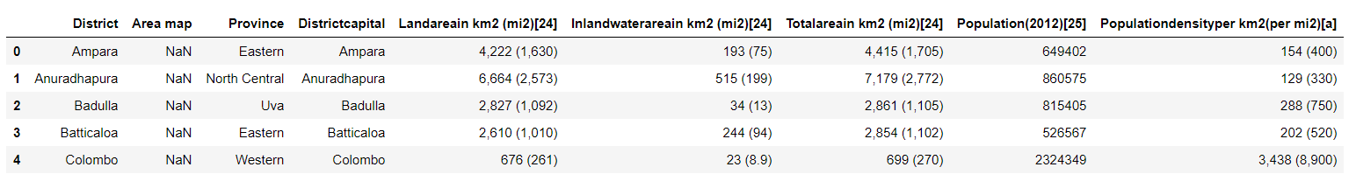
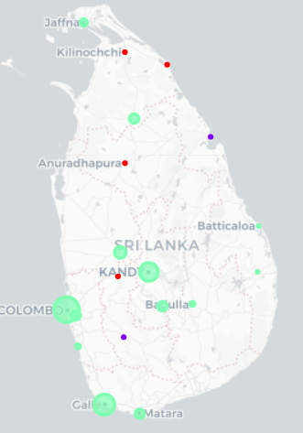
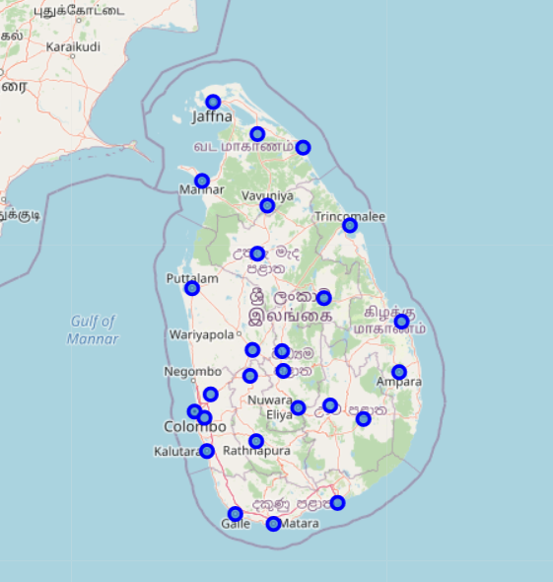
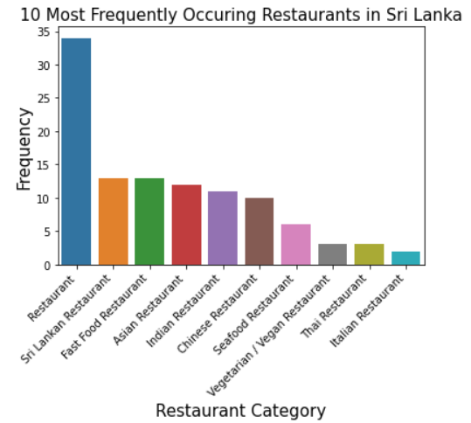
Methodology
Find the area level
Obtain restaurants nearby
Obtaining the anticipated areas
Locate them in the map
Find the type and classify

Slide 6
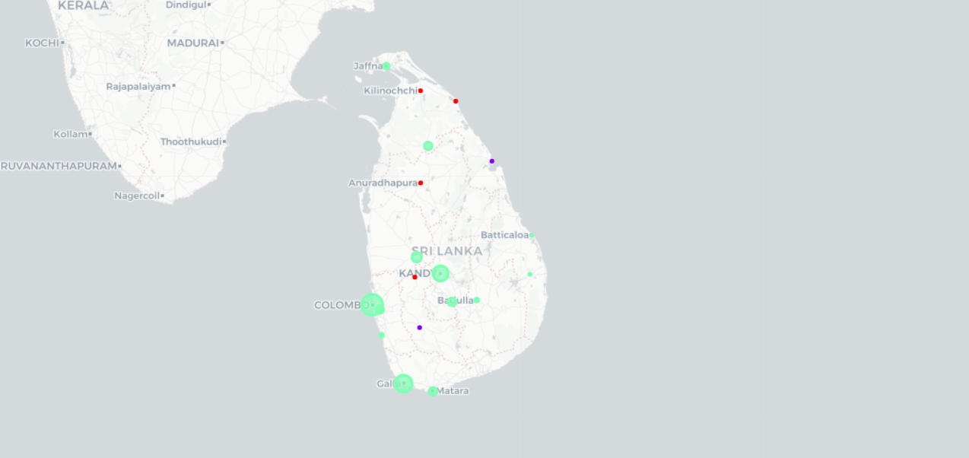
Result
After Clustering we got theses results as shown in map
Green Color – Most of the common restaurants => High Probability of authentic Sri Lankan Restaurants
Red color – Guaranteed the exitance of authentic Sri Lankan Restaurants
Purple color – Most common type is Fast-food restaurants => Less Probability of authentic Sri Lankan Restaurants

Slide 7
Conclusion
Most of the common restaurants can be found compare to the types of Restaurants so may have effect on the accuracy.
Since Data availability for Sri Lanka is small, the accuracy of the system can differ with the actual scenario.
To get more accurate recommendation system, need to collect more data in each area.

Slide 8
Thank You !

